Slide 1
Advanticsys
Weekly update – 14/04/2023
Topics to discuss:
Input Data
Output Data (reporting interval and key measure)
How to use irradiance/temp data
Rules to remove outliers

Slide 2
Input data
Energy data – Either Today_Energy or Total_Energy for each inverter
Temperature:
inverter readings
WMS reading
WMS01 for Inverters 01 – 05
WMS02 for Inverters 06 – 10
WMS irradiance:
WMS01 for Inverters 01 – 05
WMS02 for Inverters 06 – 10

Slide 3
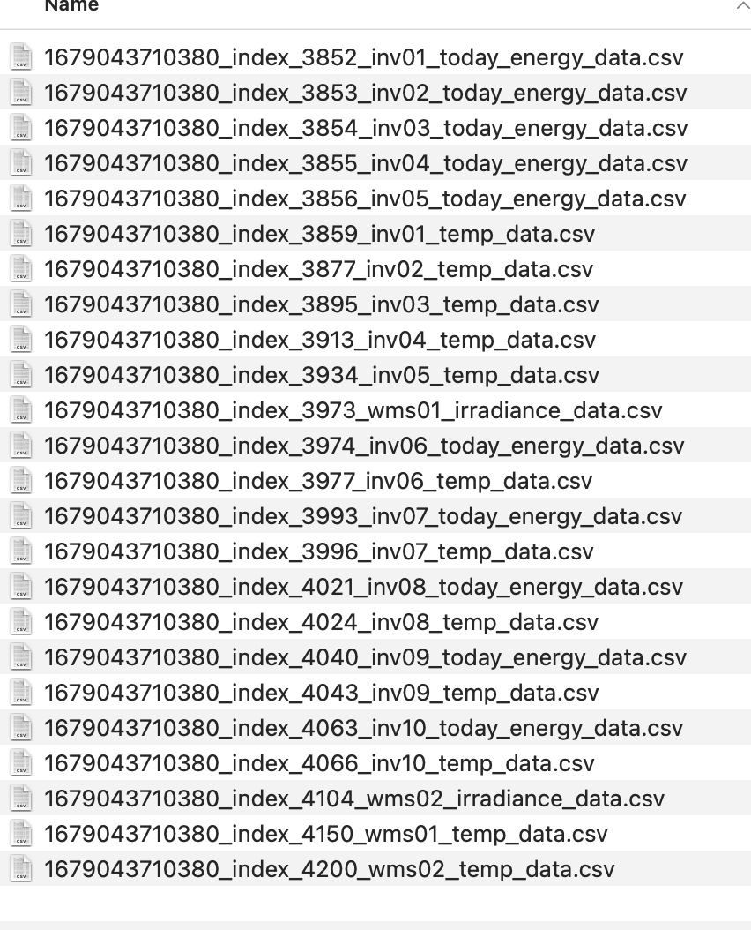
Input data

Slide 4
Output (Reporting interval and measure)
Energy data
Quarterly energy generation
Total MWh generated
Average MWh per minute in each quarter
Daily energy generation
Total MWh generated
Average MWh per minute on each day

Slide 5
Correlating irradiance/temp data
Option 1:
Use average irradiance/temp in each reporting interval
Option 2:
Use high & low irradiance/temp in each reporting interval

Slide 6
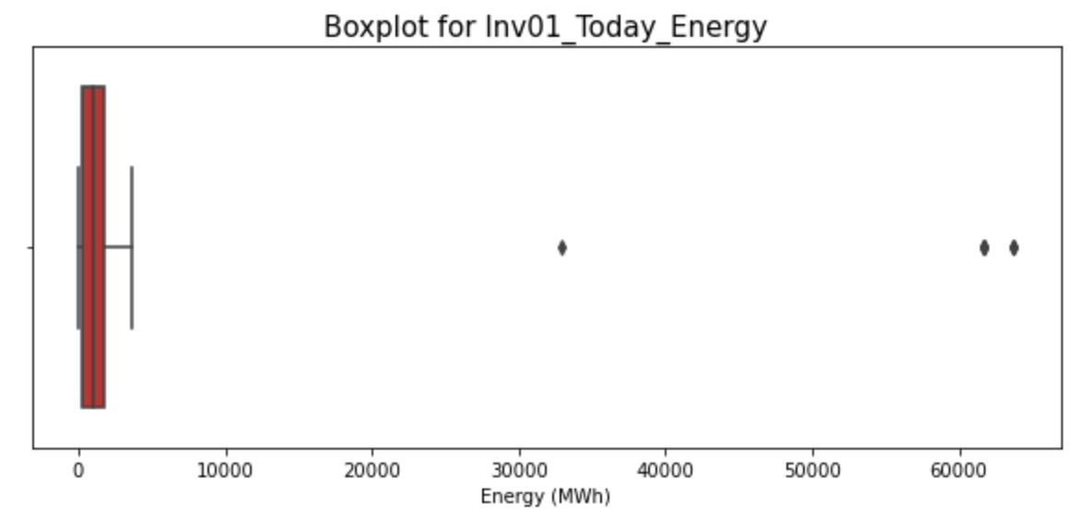
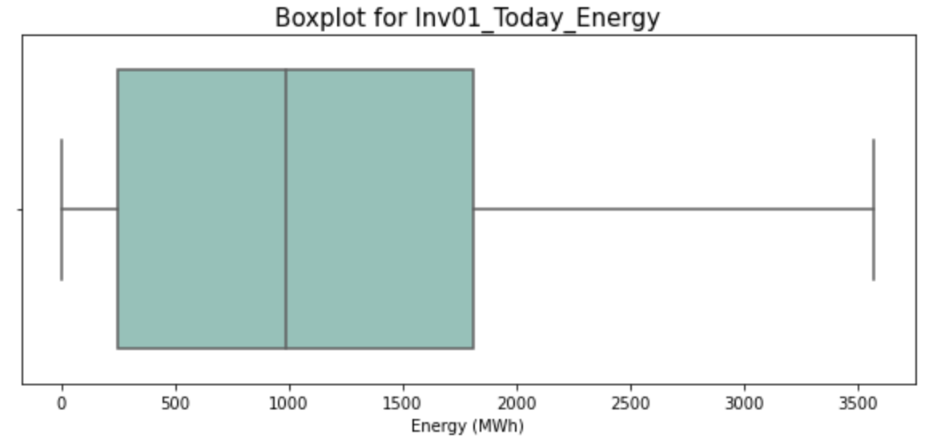
Remove outlier – Today_Energy
Step 1 - Remove 0 and negative readings
Step 2 - Remove readings higher than upper limit
Around 4000 MWh (2020)

Slide 7
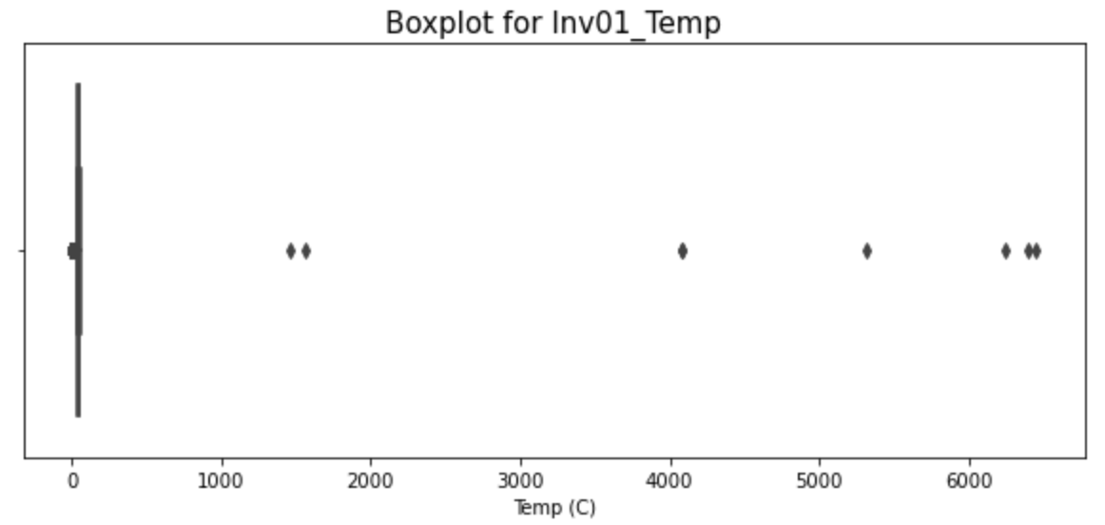
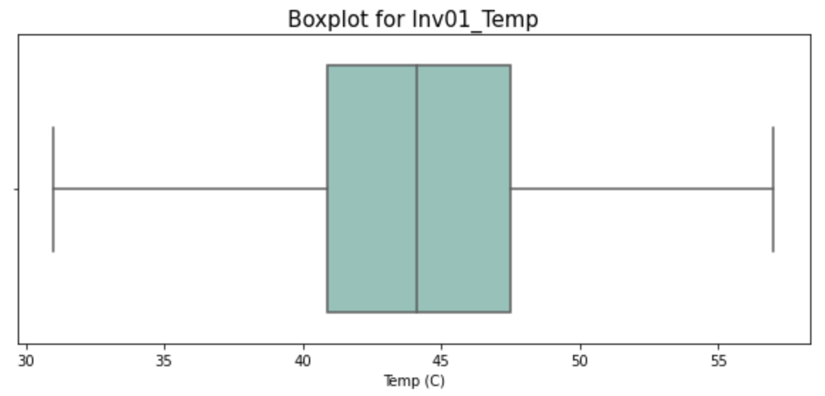
Remove outlier – Temperature (Inverter Readings)
Step 1 - Remove readings lower than lower limit
31 degree for inv01 (2020)
Step 2 - Remove readings higher than upper limit
57 degree for inv01 (2020)

Slide 8
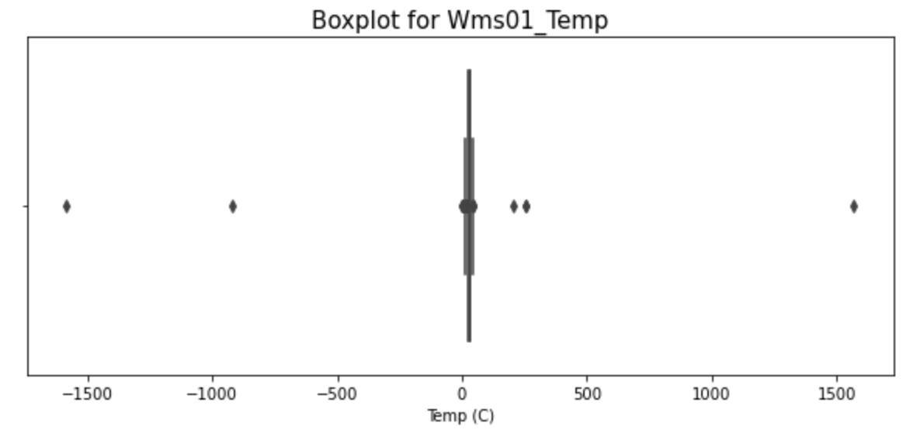
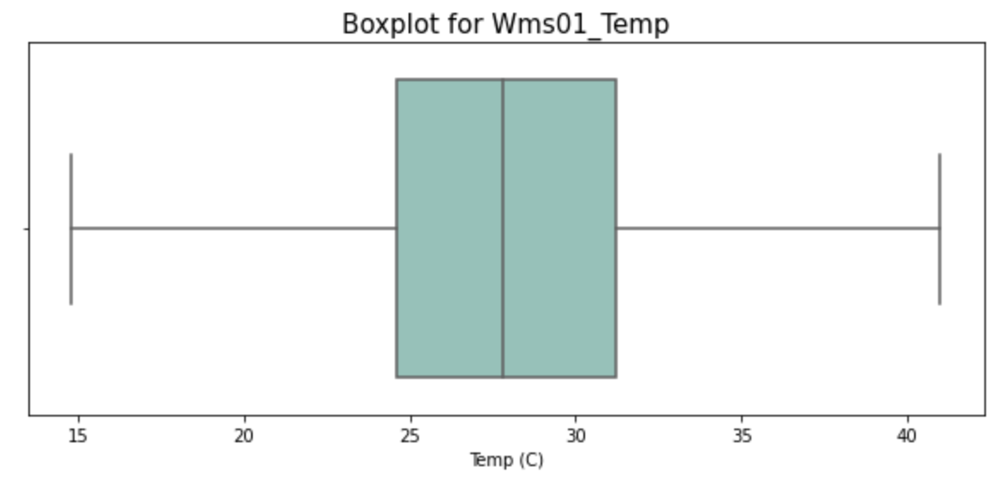
Remove outlier – Temperature (WMS Readings)
Step 1 - Remove readings lower than lower limit
15 degree for wms01 (2020)
Step 2 - Remove readings higher than upper limit
41 degree for wms01 (2020)

Slide 9
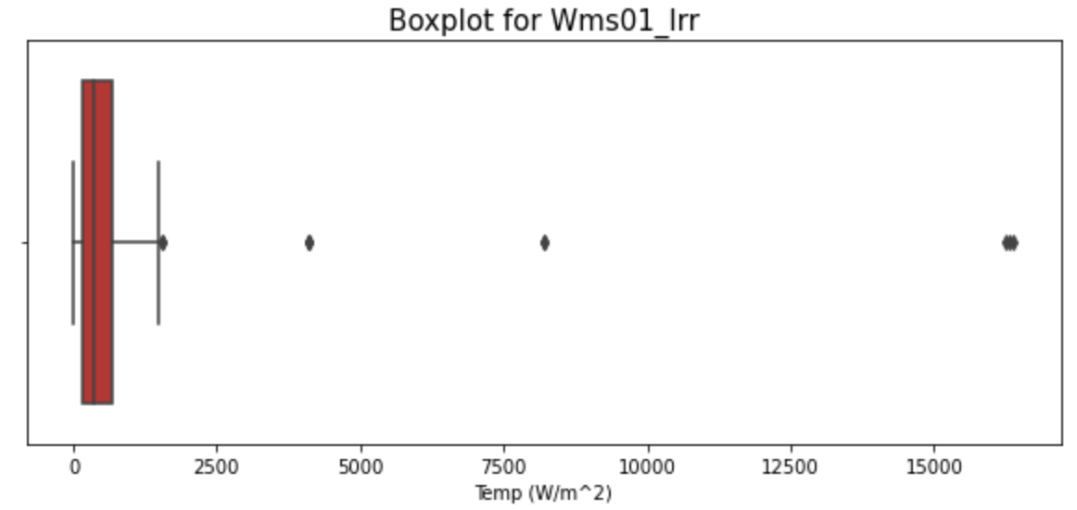
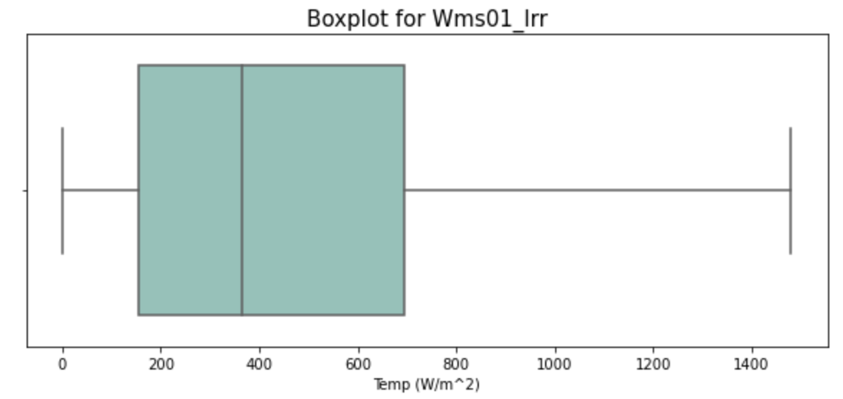
Remove outlier – Irradiance (WMS Readings)
Step 1 - Remove readings less than 0
Step 2 - Remove readings higher than upper limit
1500 W/m^2 (2020)

Slide 10
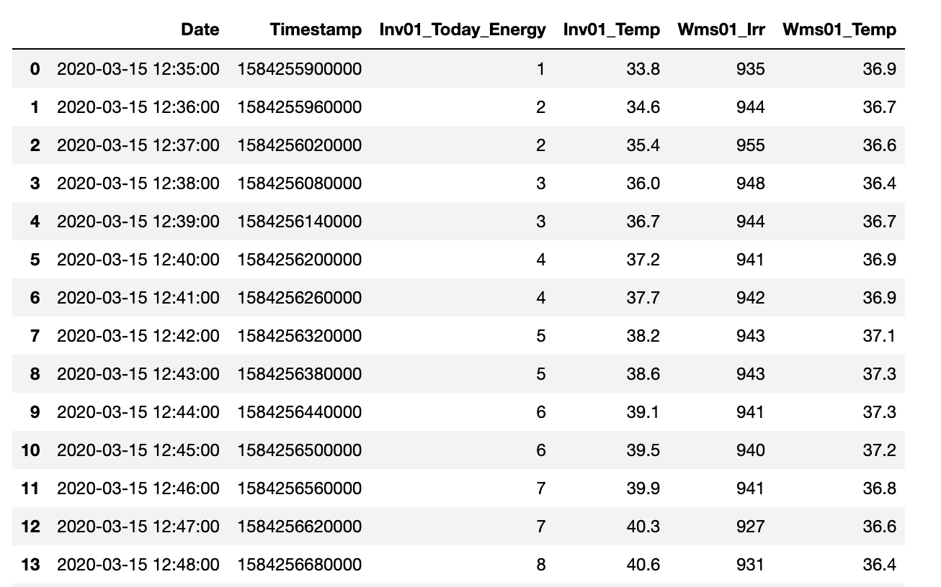
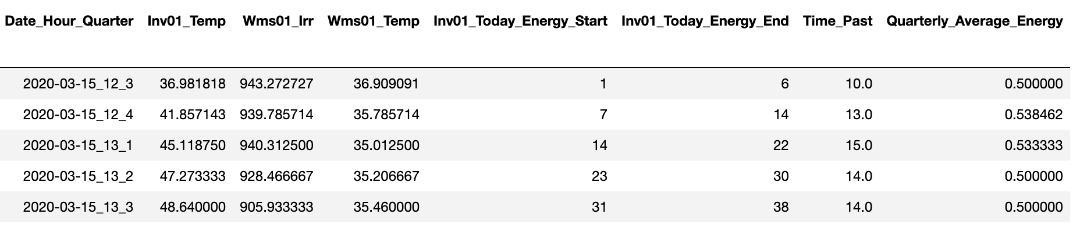
Data output for inv01 for 2020
By Minute
By Quarter
Avg energy generation per minute
Average for each quarter
Energy recording at beginning and end of each quarter

Slide 11
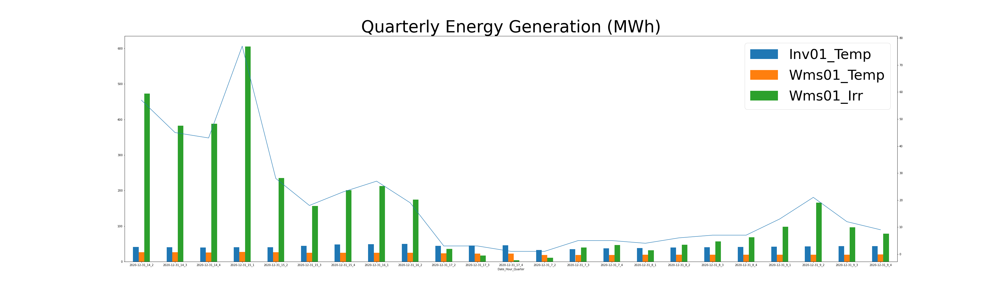

Slide 12
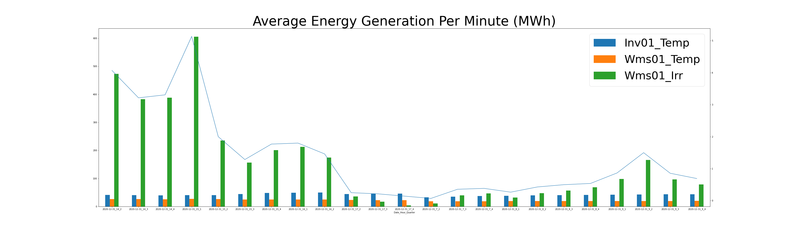

Slide 13
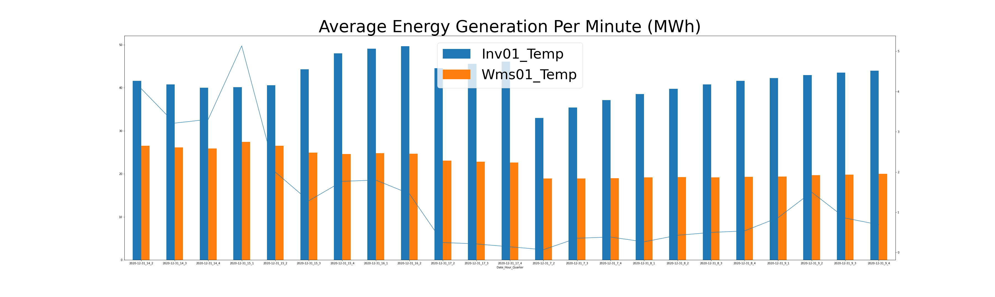

Slide 14
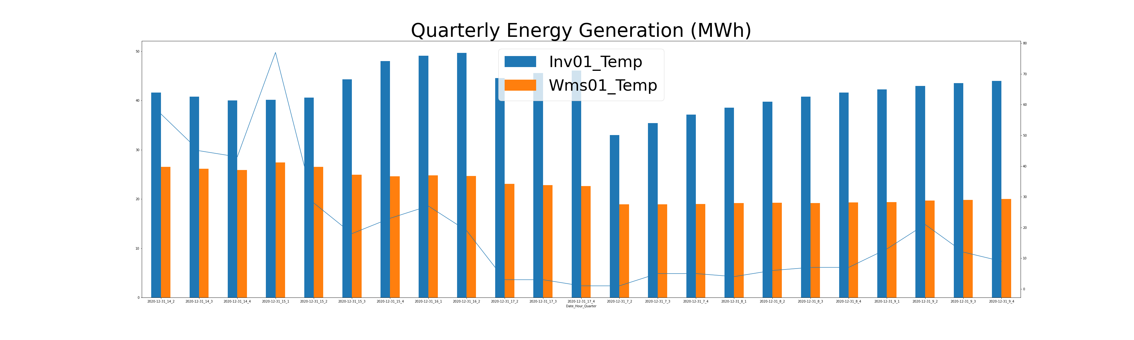

Slide 15
From last meeting: Identified required files and separated them
The following files are considered for now: today_energy_data, total_run_data, today_run_data, total_energy_data, temp_data, irradiance_data, temp_data
For each year, overall, 54 files are there.
All files are having the same structure. We will be combining the data on an inverter basis.

Slide 16
From last meeting: How should be the frequency of the reporting be?
The data available is on a minute by minute basis.
Planning to group the data with a 15 minute frequency.
Average values will be considered for this 15 min frequency.

